Slide 1
Auto ReTest Function
HT-9xxx Series
RD5
Steven Chou
2017.01.26
Rework @ 2022.05.13

Slide 2
Introduce of ART
01
Hardware Modification
02
Tray Arm
Conveyor Track
Software Function
03
ART GUI
BIN Setting
Communication Flow
04
GS32 Bin Test Mode
ART Test Command and Flow

Slide 3

Introduce of ART
Originally, operator doing RT lot in and print summary manually.
Lot in
Normal test
Print summary
RT lot in
Retest
Print summary
A
R
T
In ART function, handler swap the test mode and tell tester to print summary AUTOMATICALLY.

Slide 4

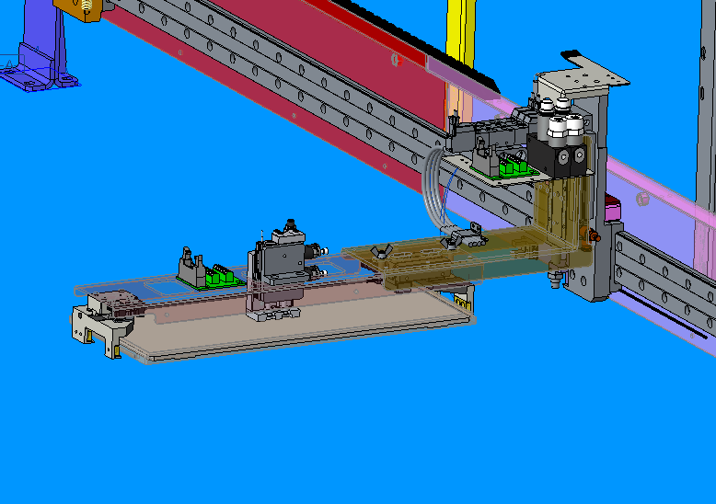
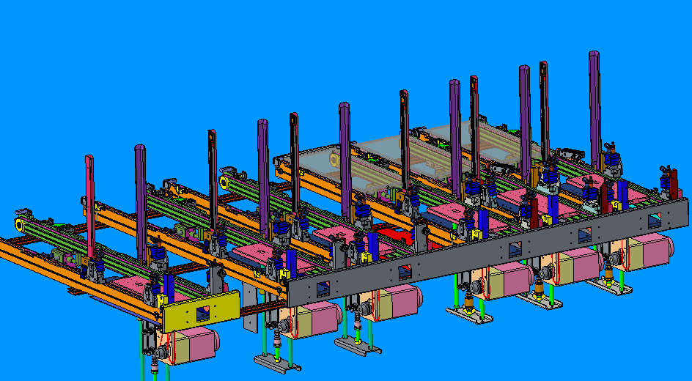
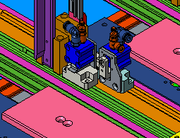
Hardware Modification
Tray Arm
Conveyor Track
Change to chuck type.
Add cover.
Must be 6 auto track.
All conveyor can move tray in and out.
Separator of unloader use cylinder.

Slide 5

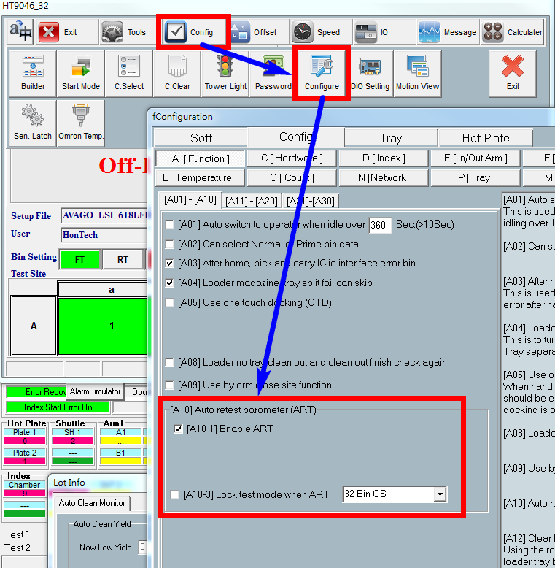
Software Function
[A10] Auto retest parameter
Enabled function [A10-1] to use ART function.
[A10-3] can lock the test mode to specify protocol.

Slide 6
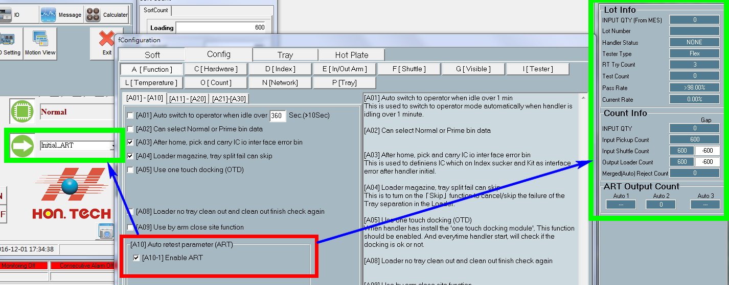
Software Function
Main GUI
Add ‘Initial ART’ in running mode.
Additional panel for ART information.

Slide 7
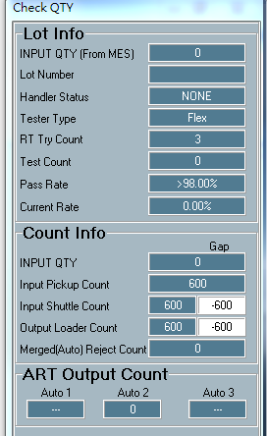
Software Function
Check QTY
QTY provide by tester.
Lot number provided by tester.
Maximum RT count.
Current RT count.
No RT bin yield to stop ART.
Current yield for ART pass category.
Devices count which need to load.
Devices count which pick up from loader.
Devices count which place to in shuttle.
Device count which place to unloader.
Device count which need to RT
Device count for each auto unloader which need to RT.

Slide 8
Software Function
Check QTY
Gap counts devices count which happened error.
The error include:
In arm pick error on hot plate with skip action.
In arm drop error with skip action.
Gap counts devices count which happened error.
The error include:
Index pick up error on shuttle with skip action.
Index device drop error with skip action.
Device lose at out shuttle.
Out arm pick error on hot plate with skip action.
Out arm drop error with skip action.

Slide 9
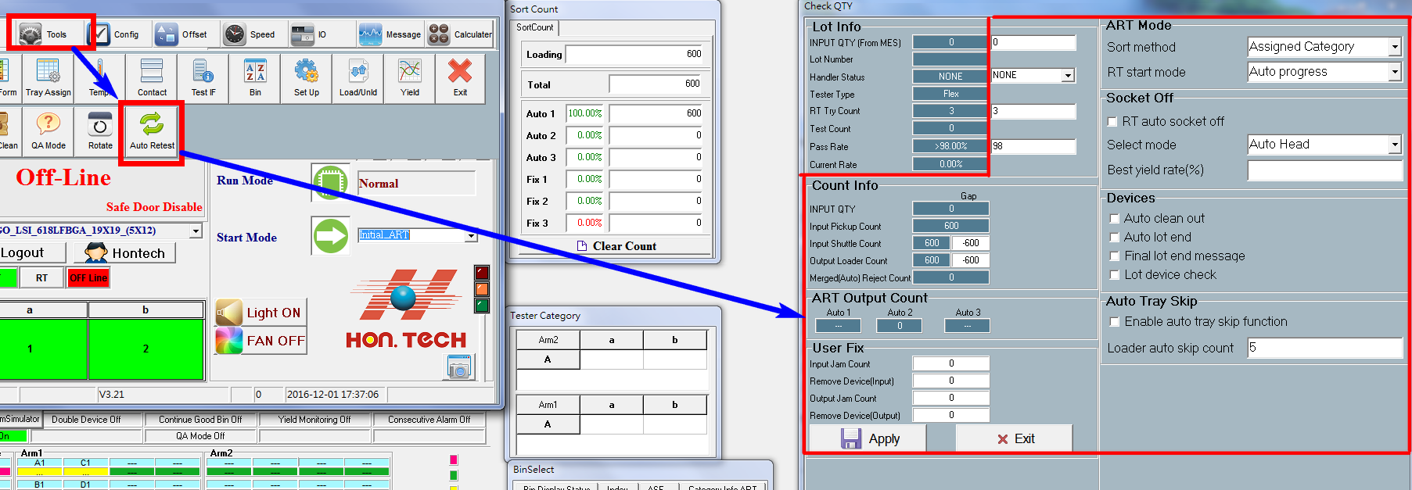
Software Function
Active setting panel for ART.

Slide 10
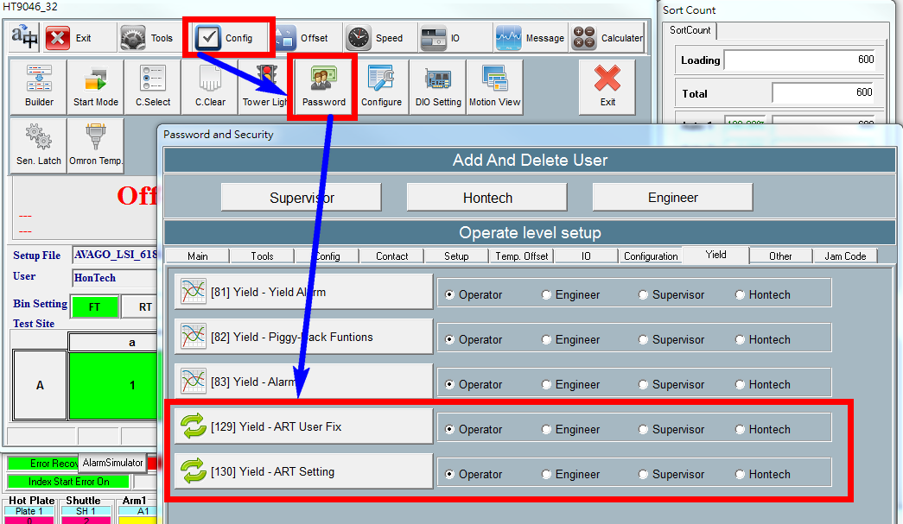
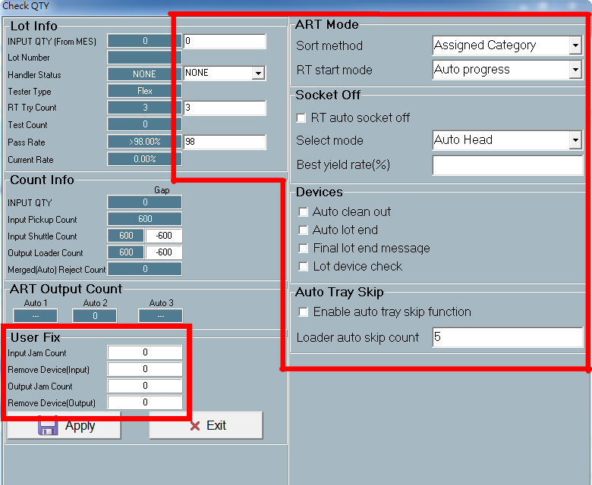
Software Function
Level Set for ART Setting Panel
Control by [130] Yield – ART Setting
Priority of ART setting panel
Control by [129] Yield – ART User Fix

Slide 11
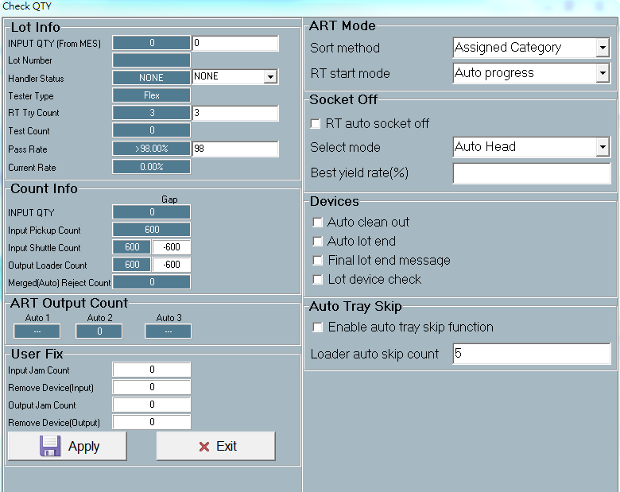
Software Function
ART Lot Info
Modify for input quantity by engineer.
Modify for handler status by engineer.
Modify for RT try count.
Modify for pass rate.

Slide 12
Software Function
ART Additional Setting
Sort mode include: Assigned Category and Category R.
RT start mode can choose :
Auto progress : change status automatically.
Manual progress : alarm and wait user to start.
Handler will turn off the DUT when running RT. And can set the rule to close site.
When handler have such status, user can decides to alarm or auto change handler status to next step.
When in arm pick up error, it can auto skip to next device.

Slide 13
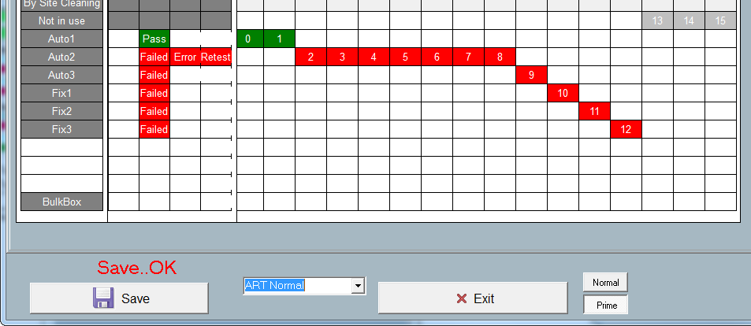
Software Function
Assigned Category
In ART mode, we will use bin setting as
  ART-Normal for FT and RT;
  ART-Retest bin setting for final RT.
In this case, only the bin setting on Auto 2 will do retest.

Slide 14
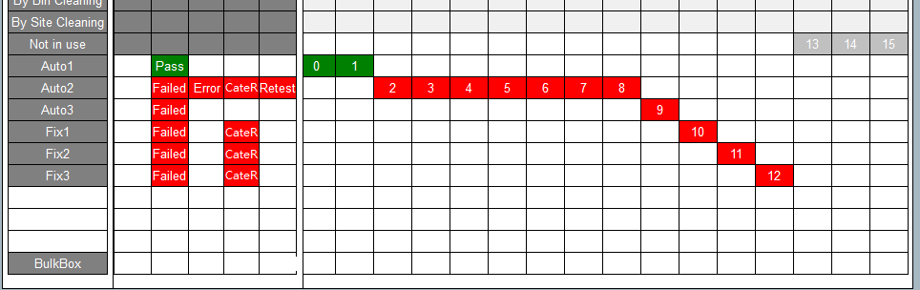
Software Function
Category R
You can set bin combine to bin R when FT and RT to one unloader.
And it will be separate to define bin in final RT.
In this case, Auto 2, Fix 1, Fix 2 and Fix 3 will combine bin to Auto 2 when FT and RT.
And will separate bin in final RT

Slide 15
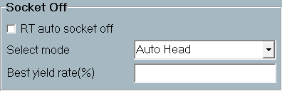
Software Function
Auto Socket Off
Socket can be turn off when RT and turn on in FT.
Function | Description
Auto Head | Compare to the head has best yield, if lower than setting rate, the site by such head will be close.
Auto Socket | Compare to the socket has best yield, if lower than setting rate, the site will be close.
Manual | User can select which head or site to close.

Slide 16
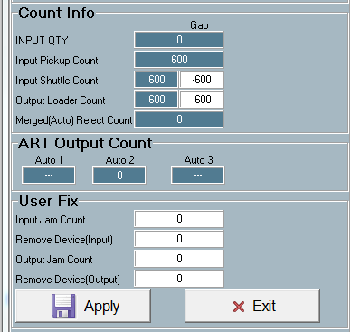
Software Function
Correction QTY
You can use the user fix tool to correction the quantity when number is not match.
Input count need to RT.
Input count NO need to RT.
Output count need to RT.
Output count NO need to RT.

Slide 17
Software Function
Correction QTY
You can try the formula in excel to know how correction works.

Slide 18

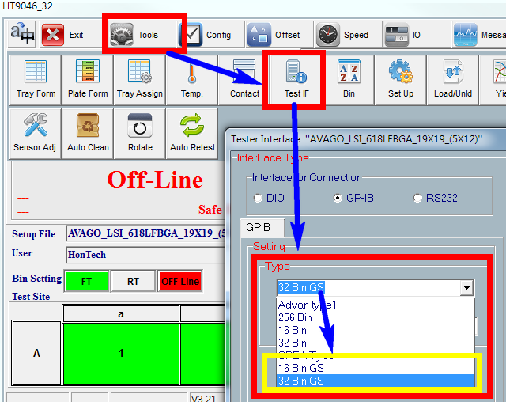
Communication Flow
New GPIB Bin Type
We add 16 bin GS and 32 bin GS in GPIB test type. You can change mode in Test IF panel.

Slide 19
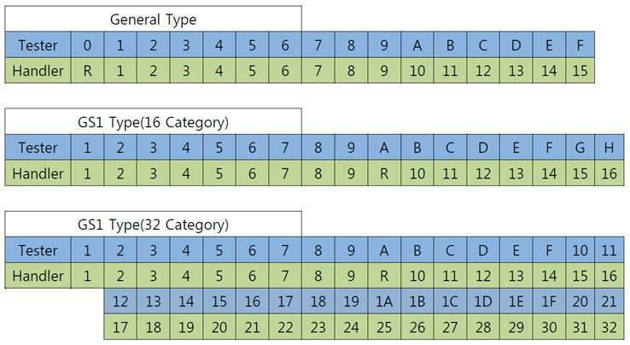
Communication Flow
New Test Mode
The bin mapping and BINON command of General Type, 16 bin GS and 32 bin GS are as the table below.
Mode | GPIB BINON command
General | BINON:00000000,00000000,00000000,FEDC4321;
16 Bin GS | BINON:A,A,A,A,A,A,A,A,A,A,A,A,A,A,A,A,A,A,A,A,A,A,A,A,G,F,E,D,4,3,2,1;
32 Bin GS | BINON:A,A,A,A,A,A,A,A,A,A,A,A,A,A,A,A,A,A,A,A,A,A,A,A,10,F,E,D,4,3,2,1;

Slide 20


Communication Flow
General Flow of ART
Handler
Tester
Initial Lot
Lot Info
Doing FT test
FT Lot End
Request FT lot End
Print Summary
RT Start
Auto Move RT Tray to Loader
Doing RT test
RT Lot End
Yes
Need RT?
No
Request Final Lot End
Print Summary
Lot End

Slide 21
Communication Flow
Initial Tester Connection of ART
Handler
Tester
Tester Connect
FR?
FR0
DL 0
SRQMASK FF
Go to Lot Information

Slide 22
Communication Flow
Initial Lot Information of ART
Handler
Tester
Initial Lot
LOTCLEAR?
LOTCLEARED
NN : Lot IC count.
XX : Lot ID
INPUTQTY NN,XX
SETTINGOK / SETTINGNG
Got SETTINGOK?
No
Yes
Go to FT Lot Start

Slide 23
Communication Flow
FT Lot Start
Handler
Tester
FT Lot Start
SRQ 0xC0
2 : First time lot start
SRQKIND?
SRQKIND 2
Tester is ready for testing.
LOTORDER 0
Testing
Go to Lot End Flow

Slide 24
Communication Flow
Lot End
Handler
Tester
Lot End
SRQ 0xC0
SRQKIND?
No
Need RT?
8 : FT / RT lot end.
Yes
SRQKIND 8
LOTRETESTCLEAR?
LOTRETESTCLEARED
2 : Print summary.
LOTORDER 2
Go to Final Lot End
Auto Move RT Tray to Loader
Go to RT Lot Start

Slide 25
Communication Flow
RT Lot Start
Handler
Tester
RT Lot Start
SRQ 0xC0
4 : RT lot start
SRQKIND?
SRQKIND 4
Tester is ready for testing.
LOTORDER 0
Testing
Go to Lot End Flow

Slide 26
Communication Flow
Final Lot End
Handler
Tester
Final Lot End
SRQ 0xC0
10 : Final RT lot end
SRQKIND?
SRQKIND 10
2 : Print summary.
LOTORDER 2
Tray Feed and End of ART Flow

Slide 27
Communication Flow
Command List of ART
Tester Command | Description | Reply by Handler
LOTCLEAR? | Request to clear lot data on handler. | LOTCLEARED : all lot data is cleared. SETTINGNG : can not cleat lot data.
INPUTQTY NN,XX | Set lot quantity to handler. NN is count of IC in lot. XX is Lot ID. | SETTINGOK : nothing error. SETTINGNG : can not set lot data.
SRQKIND ? | Asking handler for running status. | SRQKIND 2 : FT lot start. SRQKIND 4 : RT lot start. SRQKIND 8 : lot end. SRQKIND 10 : final lot end.
LOTORDER X | By the SRQKIND command, tester will reply LOTORDER. | LOTORDER 0 : handler can start running. LORORDER 2 : Reply to perform ART or clean out lot end.
LOTRETESTCLEAR? | Request to clear lot data on handler. | LOTRETESTCLEARED: all lot data is cleared. SETTINGNG : can not cleat lot data.

Slide 28
Thank you

